Slide 1
Module 1
Installing, upgrading, and migrating servers and workloads
Notes:
Presentation: 85 minutes
Lab: 60 minutes
After completing this module, students will be able to:
Describe the new features of Windows Server 2016.
Prepare for and install Server core.
Plan a server upgrade and migration strategy.
Perform a migration of server roles and workloads within a domain and across domains.
Choose an appropriate activation model.
Required materials
To teach this module, you need the Microsoft PowerPoint file 20740C_01.pptx.
Preparation tasks
To prepare for this module, you should:
Read all of this module’s materials.
Practice performing the demonstrations and labs.
Work through the Module Review and Takeaways section to determine how you will use the information to reinforce student learning and promote knowledge transfer to on-the-job performance.
As you prepare for this class, it is imperative that you complete the labs yourself. This gives you an understanding of how the labs work, as well as the concepts that each lab covers. This enables you to provide meaningful hints to students who might have issues while working in the labs. Furthermore, it will help guide your lecture to ensure that you discuss the concepts that the labs cover.
20740C
1: Installing, upgrading, and migrating servers and workloads

Slide 2
Module Overview
Introducing Windows Server 2016 Preparing and installing Server Core Preparing for upgrades and migrations Migrating server roles and workloads Windows Server activation models
Notes:
Provide an overview of the module.
20740C
1: Installing, upgrading, and migrating servers and workloads

Slide 3
Lesson 1: Introducing Windows Server 2016
Selecting a suitable Windows Server 2016 edition Hardware requirements Overview of installation options Managing servers remotely Using Windows PowerShell 5.0 to manage servers What’s new since Windows Server 2008 was released? Windows Server Servicing Channels
Notes:
Provide an overview of the lesson.
Question
Docker is a container that enables you to run an app in an isolated and portable operating environment.
( ) False
( ) True
Answer
( √) False
( ) True
Feedback
Docker is a management tool that you can use to manage Windows and Hyper V container images.
Question
What new features in Windows Server 2016 do you think will be useful in your organization?
Answer
Answers will vary.
20740C
1: Installing, upgrading, and migrating servers and workloads

Slide 4
Selecting a suitable Windows Server 2016 edition
Windows Server 2016 Essentials
Windows Server 2016 Standard
Windows Server 2016 Datacenter
Microsoft Hyper-V Server 2016
Windows Storage Server 2016 Workgroup
Windows Storage Server 2016 Standard
Notes:
When discussing each edition of Windows Server 2016, mention the situations for which each edition is appropriate. For example, the Windows Server 2016 Standard edition is an appropriate choice for a file server or domain controller at a branch office. The Windows Server 2016 Datacenter edition provides benefits for large-scale virtualization deployments. One aspect of deployment involves selecting the appropriate edition to meet a specific set of needs.
20740C
1: Installing, upgrading, and migrating servers and workloads

Slide 5
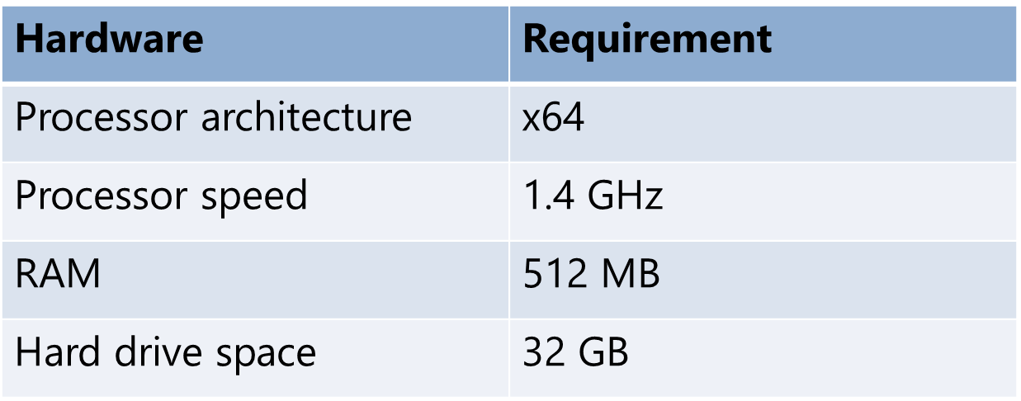
Hardware requirements
Windows Server 2016 has the following minimum hardware requirements for Server Core installation:
Notes:
Discuss the minimum system requirements of Windows Server 2016. Discuss the reasons why your students should avoid deploying a server on the minimum required hardware, such as:
Poor performance.
A limited ability to handle increases in load. For example, if they deploy the web server role, the web server will process only a limited amount of traffic before experiencing performance problems.
Explain that the maximum capacity of Windows Server 2016 depends on the edition. For example, the Windows Server Datacenter edition supports up to a maximum of the following hardware:
640 logical processors
4 TB of RAM
64 failover cluster nodes
20740C
1: Installing, upgrading, and migrating servers and workloads

Slide 6
Overview of installation options
You can choose among the following installation options when deploying Windows Server 2016:
Windows Server 2016 (Desktop Experience)—full server installation
Windows Server 2016—Server Core installation
Windows and Hyper-V containers can run on a Desktop Experience or Server Core of Windows Server 2016, and provide further application isolation
Notes:
Briefly discuss each installation option. Server Core is discussed in more detail in the following topics. Module 6 discusses the Windows operating system and Hyper-V containers.
20740C
1: Installing, upgrading, and migrating servers and workloads

Slide 7
Managing servers remotely
Use the following options to remotely manage a computer that is running Windows Server 2016:
Remote Server Administration Tools (RSAT)
Server Manager
Management consoles for each role/feature
Windows PowerShell remoting and PowerShell Direct
Remote shell
Remote Desktop
Group Policy (not supported on Nano Server)
Firewall exceptions required for remote management
Notes:
Consider demonstrating these options.
20740C
1: Installing, upgrading, and migrating servers and workloads

Slide 8
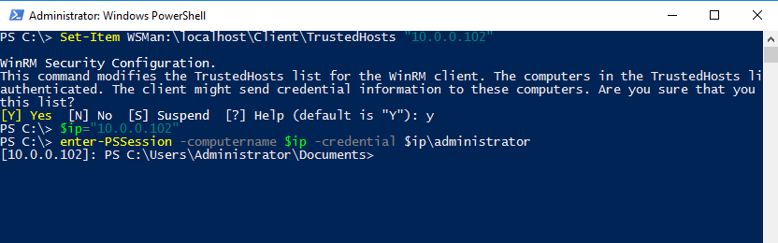
Using Windows PowerShell 5.0 to manage servers
Windows PowerShell is a scripting language and command-line interface that is designed to assist you in performing day-to-day administrative tasks
Notes:
You will be demonstrating Windows PowerShell in the next few topics.
20740C
1: Installing, upgrading, and migrating servers and workloads

Slide 9
What’s new since Windows Server 2008 was released?
New features and improvements introduced in Windows Server 2012 or Windows Server 2012 R2:
Work Folders
DHCP failover
IPAM
Dynamic Access Control
Data deduplication
Storage Spaces
Storage tiers
Better domain controller virtualization
Cloning virtual domain controllers
Notes:
Although some students will have experience with Windows Server 2012, the target audience for this course consists of users from organizations that have Windows Server 2008 deployed. You can present this material either as a list of improvements in Windows Server 2016 since Windows Server 2008 was released or as two sets of improvements: the first from Windows Server 2008 to Windows Server 2012 and the second since Windows Server 2012 was released.
Mention to the students that some of these features and improvements will be covered in more detail later in the course.
20740C
1: Installing, upgrading, and migrating servers and workloads

Slide 10
What’s new since Windows Server 2012 was released?
New features and improvements introduced in Windows Server 2016:
Containers
Docker support
Rolling upgrades for Hyper-V and storage clusters
Hot add/remove virtual memory & network adapters
Nested virtualization
PowerShell Direct
Shielded virtual machines
Windows Defender
Storage Spaces Direct
Storage Replica
Remote Desktop Services
Microsoft Passport
Azure AD Join support
Privileged Access Management
Notes:
Mention that these features and improvements will be covered in more detail later in the course or in the related courses.
20740C
1: Installing, upgrading, and migrating servers and workloads

Slide 11
Windows Server Servicing Channels
Windows Server 2016 now uses the Windows-as-a-Service servicing model known as Channels
Semi-Annual Channel
Contains new or updated features released every six months
Only available through a Microsoft SA Agreement
LTSC
Traditional deployment and versioning
Available in Server Core or Server with Desktop Experience modes
Both channels will release security and driver updates as required as soon as available
Nano Server no longer supported with infrastructure roles; use Server Core or Desktop Experience modes instead
Notes:
Explain that due to the frequency of changes, this course will not discuss the Semi-Annual Channel version. Note that the development of the channels came from the Windows-as-a-Service servicing model developed for Windows 10, and was subsequently applied to Microsoft Office 365 and System Center 2016 Configuration Manager. All the initially deployed different branches are now referred to as channels.
One important item is that Nano Server is no longer supported as an infrastructure platform in LTSC. Organizations should move Nano Server infrastructure roles over to a Windows Server Core or with Desktop Experience feature mode.
20740C
1: Installing, upgrading, and migrating servers and workloads

Slide 12
Lesson 2: Preparing and installing Server Core
Planning for Server Core Installing Server Core and Server with Desktop Experience Post-installation configuration settings Discussion: selecting a suitable Windows Server edition and installation type Demonstration: Installing Server Core
Notes:
Provide an overview of the lesson.
Question
Which of the following commands do you use to initiate remote Windows PowerShell management?
( ) Option 1: Enter-PSSession -Name
( ) Option 2: Enter-PSRemote -Name
( ) Option 3: Enter-PSSession -ComputerName
( ) Option 4: Enter-PSRemote -ComputerName
Answer
( ) Option 1: Enter-PSSession -Name
( ) Option 2: Enter-PSRemote -Name
( √) Option 3: Enter-PSSession –ComputerName
( ) Option 4: Enter-PSRemote -ComputerName
Feedback
Use the Enter-PSSession –ComputerName cmdlet to initiate remote Windows PowerShell.
20740C
1: Installing, upgrading, and migrating servers and workloads

Slide 13
Planning for Server Core
Server Core is:
A more security-enhanced, less resource-intensive installation option than the Desktop Experience installation
An installation that cannot be converted to a full graphical shell version of Windows Server 2016
The default installation option for Windows Server 2016
Managed locally by using Windows PowerShell and other standard tools
With remote management enabled, you rarely need to sign in locally
Notes:
Mention the following advantages of Server Core:
It requires a smaller hardware footprint than Windows Server with Desktop Experience
It reduces servicing requirements.
Inform students that they can run remote administration tools from client computers that are running appropriate editions of the Windows 10 operating system.
20740C
1: Installing, upgrading, and migrating servers and workloads

Slide 14
Installing Server Core and Server with Desktop Experience
Perform preinstallation tasks:
Disconnect UPS
Back up server if applicable
Disable antivirus software
Run the Windows Setup Wizard from the installation media:
Provide locale information (language, date, currency, keyboard)
Select Server Core Installation
Review and accept license
Select installation location
Provide administrator password
Notes:
The installation process for Server Core or Server with Desktop Experience is the same. The only difference is the option chosen within the Setup wizard.
Also point out that students can download VHDs of Windows Server 2016 from the TechNet Evaluation Center.
20740C
1: Installing, upgrading, and migrating servers and workloads

Slide 15
Post-installation configuration settings
After you install Windows Server 2016, you must complete the following:
Configure the IP address
Set the computer name
Join an Active Directory domain
Configure the time zone
Enable automatic updates
Add roles and features
Enable the Remote Desktop feature
Configure Windows Firewall settings
Notes:
You will demonstrate these configuration tasks on the next demonstration. However, consider demonstrating these configuration options by using Server Manager on one of the installed virtual machines.
20740C
1: Installing, upgrading, and migrating servers and workloads

Slide 16
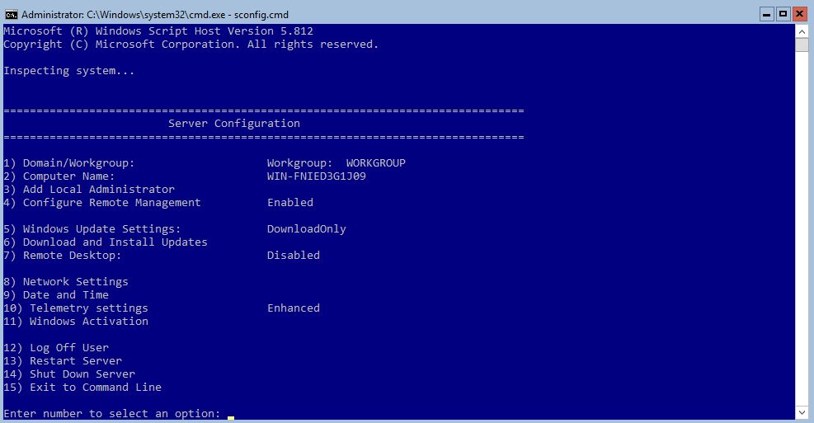
Sconfig.cmd interface screen
Notes:
You will be demonstrating the use of Sconfig.cmd in the next demonstration. This provides an illustration for understanding the use of Sconfig.cmd as part of the text of this topic slide.
20740C
1: Installing, upgrading, and migrating servers and workloads

Slide 17

Discussion: selecting a suitable Windows Server edition and installation type
Which Windows Server 2016 installation option would you select?
10 minutes
Notes:
Present the question and then each of the scenarios. Spend 5–10 minutes talking about student responses before moving on.
Question
Your customer, a small legal firm, has a requirement for a single server that they want you to deploy at their only office. Which Windows Server 2016 installation option would be best?
Answer
Deploying Windows Server 2016 with Desktop Experience offers the best solution here. It provides for the most roles and features, and enables local management to be performed.
Question
One of your enterprise customers has a new branch office. You must deploy Windows Server 2016 to support the local users at this new branch. The server will be managed remotely from IT staff located in the head office. The server will support the DNS, DHCP, and AD DS server roles. Your customer wants to minimize resource consumption on the server. Which Windows Server 2016 installation option would be best?
Answer
Nano Server is no longer supported in LTSC, so it isn’t a good choice in terms of remote management. Therefore, the logical choice is Server Core.
20740C
1: Installing, upgrading, and migrating servers and workloads

Slide 18
Lesson 3: Preparing for upgrades and migrations
In-place upgrades vs. server migration In-place upgrade scenarios Benefits of migrating to Windows Server 2016 Using solution accelerators Recommendations for server consolidation Demonstration: Using MAP
Notes:
Briefly introduce the topics in this lesson, and inform students that each topic presents scenarios they should consider when planning their Windows Server 2012 operating system deployment.
Question
How does virtualization help in server role consolidation?
Answer
Virtualization allows you to take advantages of separating roles onto different servers. For example, you can more easily troubleshoot issues, you can better manage service uptime, and so on. At the same time, you also gain the advantage of consolidating multiple roles onto fewer computers. You must ensure that there are enough hardware resources on the virtualization hosts to handle the various workloads.
20740C
1: Installing, upgrading, and migrating servers and workloads

Slide 19
In-place upgrades vs. server migration
Upgrading to Windows Server 2016:
Can upgrade from Windows Server 2008 R2 or later
Can only upgrade to same or newer editions
Requires same processor architecture
Migrating to Windows Server 2016:
Must migrate from x86 version of Windows Server
Can use the Windows Server Migration Tools feature
Notes:
Explain the main differences between an in-place upgrade and server migration. Explain that you plan to describe scenarios for each of these procedures in next topic.
20740C
1: Installing, upgrading, and migrating servers and workloads

Slide 20
In-place upgrade scenarios
Perform an in-place upgrade when:
Existing servers meet hardware requirements
Software products installed on an existing server support an in-place upgrade
You want to keep existing data and security permissions
You want to keep existing roles, features, and settings
Notes:
Describe the scenarios in which an organization might choose an in-place upgrade.
20740C
1: Installing, upgrading, and migrating servers and workloads

Slide 21
Benefits of migrating to Windows Server 2016
When you perform a migration, you:
Do not affect your current Windows Server 2008 or later IT infrastructure
Perform software product migration in a separate environment
Perform migration of server roles, features, and settings in a separate environment
Ensure new operating system enhancements are installed by default
Notes:
Describe the scenarios in which organizations would benefit from performing a migration rather than an in-place upgrade.
20740C
1: Installing, upgrading, and migrating servers and workloads

Slide 22
Using solution accelerators
Use Microsoft Deployment Toolkit (MDT) to:
Automate deployments of Windows Server 2016 or other Windows operating systems
Use MAP Toolkit for Windows Server 2016 to:
Perform inventory of your organization’s IT infrastructure
Generate a report or proposal based on the Windows Server 2016 Readiness Assessment to plan server consolidation
Use Windows Server Migration Tools to:
Migrate server roles, features, operating system settings, data, and shares
Notes:
Discuss the tools required for planning the upgrade and migration process, such as Microsoft Application and Planning Toolkit (MAP). Explain that MAP is a no cost tool that your students can download from the Microsoft website to help with planning server deployment and consolidation; explain how MAP works.
20740C
1: Installing, upgrading, and migrating servers and workloads

Slide 23
Recommendations for server consolidation
Analyze if cohosting of multiple roles is supported
Deploy roles that are not supported for cohosting on additional servers
Determine if cohosting multiple roles affects server performance (it should not)
Analyze if cohosted roles are supported for high availability
Notes:
Explain that different scenarios apply for small, medium, and large companies. Stress that students should refer to technical documentation about best practices for cohosting different roles with respect to performance and high availability.
Explain what cohosting means and mention how virtualization achieves physical cohosting with isolated/virtualized hosting.
20740C
1: Installing, upgrading, and migrating servers and workloads

Slide 24
Lesson 4: Migrating server roles and workloads
Migrating server roles within a domain Migrating server roles across domains or forests
Notes:
Briefly introduce the topics in this lesson.
Question
What are some reasons you would do a cross-forest migration instead of a migration within the same domain?
Answer
You might want to migrate to a new forest as part of reorganizing your AD DS structure. This is an opportunity to optimize and reduce complexity.
A cross-forest migration could also be necessary as part of a business merger or acquisition.
By performing a cross-forest migration, both the new and old structure will exist at the same time, which will allow you to roll back to the previous structure if there are problems during migration.
20740C
1: Installing, upgrading, and migrating servers and workloads

Slide 25
Migrating server roles within a domain
The roles that you can migrate from supported earlier editions of Windows Server to Windows Server 2016 include:
AD FS Role Services
Hyper-V
DHCP
DNS
Network Policy Server
Print and Document Services
Remote Access
WSUS
Notes:
Describe the roles that you can migrate from earlier editions of Windows Server to Windows Server 2016.
20740C
1: Installing, upgrading, and migrating servers and workloads

Slide 26
Migrating server roles across domains or forests
When migrating serves across domains:
Create a new Windows Server 2016 AD DS forest
Deploy applications on new servers
Establish AD DS trust between the current and the new AD DS forests
Migrate AD DS objects
Migrate application data and settings
Decommission and remove the old AD DS environment
Notes:
Explain the high-level overview of steps for migrating an IT infrastructure from Active Directory Domain Servers (AD DS) based on a previous operating system version, to a new AD DS, based on the Windows Server 2016 operating system. Inform students that the current version of the Microsoft Active Directory Migration Tool only supports migrations to AD DS forests based on Windows Server 2008 R2 or later. Therefore, they might need to consider migrating AD DS to a forest based on Windows Server 2008 R2 domain controllers, and then migrating the domain controllers in the new AD DS forest to Windows Server 2016. Furthermore, explain to students that they can use third-party tools for AD DS forest migration. Caution that migrating IT infrastructure across domains should be a business-driven requirement because many cycles of testing, planning, and correcting must be endured based on the number of services to migrate in the new domain.
20740C
1: Installing, upgrading, and migrating servers and workloads

Slide 27
Lesson 5: Windows Server activation models
Windows Server 2016 licensing and activation Discussion: Planning volume activation
Notes:
Briefly introduce the topics in this lesson.
20740C
1: Installing, upgrading, and migrating servers and workloads

Slide 28
Windows Server 2016 licensing and activation
Organizations can choose between two activation strategies:
Activation strategy | When used
Manual | Suitable when deploying small number of servers
Automatic | Suitable when deploying larger number of servers
Notes:
Describe both activation scenarios, and explain the differences and when one or the other is a better choice.
20740C
1: Installing, upgrading, and migrating servers and workloads

Slide 29
Lab: Installing and configuring Server Core
Exercise 1: Installing Server Core Exercise 2: Completing post-installation tasks on Windows Server 2016 Core Exercise 3: Performing remote management
Logon Information
Virtual machines: 20740C-LON-DC1
20740C-LON-SVR6
User name: Adatum\Administrator
Password: Pa55w.rd
Estimated Time: 60 minutes
Notes:
Exercise 1: Installing Server Core
You determine that Server Core offers you the best installation option and decide to evaluate a server that uses Server Core.
Instructor Note: The Windows Server 2016 product DVD must be mounted in virtual machine for the lab steps to work as written.
Exercise 2: Completing post-installation tasks on Windows Server 2016 Core
You must now complete the installation of Server Core by configuring the post-installation settings and joining it to the Adatum.com domain. You will also install the DNS Server role.
Instructor Note: The 20740C-LON-SVR6 virtual machine is initially installed by default as part of a workgroup and is using a DHCP-enabled IPv4 configuration.
Exercise 3: Performing remote management
Now that you added the DNS Server role to Server Core on LON-SVR6, you want to explore configuring the DNS settings and configuration by using GUI tools on other Windows Server with Desktop Experience systems.
20740C
1: Installing, upgrading, and migrating servers and workloads

Slide 30
Module Review and Takeaways
Review Questions Tools Common Issues and Troubleshooting Tips
Notes:
Review Questions
Question
What major advantages does Server Core have over a full Windows Server 2016 installation?
Answer
Advantages include reduced update requirements, a reduced hardware footprint, and a smaller attack surface.
Question
Five years ago, your organization bought a new rack-mount server and installed Windows Server 2012 on it. You now want to install Windows Server 2016 via the upgrade method. What should you do?
Answer
First, you should verify that the hardware meets the minimum hardware requirements for Windows Server 2016. Second, ensure that the hardware is still under warranty or can have its warranty extended. Next, completely back up all data and configuration information from the original server. Finally, ensure that you have followed all specified guidelines to upgrade the operating system, its roles, and any other software or applications that are running on that server. Some applications might not run or be guaranteed by their manufacturers to work with the new operating system.
Question
Which role can you use to manage KMS?
Answer
You can use the Volume Activation Services role to manage KMS.
20740C
1: Installing, upgrading, and migrating servers and workloads
(More notes on the next slide)

